Slide 1
Algorithm
Step by step Procedure to solve a Particular problem is called ALGORITHM
Algorithm can also be called as Pseudo – Code.
Characteristics of an Algorithm:
Each and every Algorithm should satisfy the following Criteria:
a. Input
b. Output
c. Finiteness
d. Definiteness
e. Effectiveness

Slide 2
Example: Write an algorithm to find the roots of quadratic equation for all the cases.
Step 1: Input A, B, C
Step 2: Set D = B * B – 4 * A * C
Step 3: If D > 0 then :
(a)Set X1 = (-B + SQRT(D))/ 2 * A
(b)Set X2 = (-B - SQRT(D))/ 2 * A
(c) Print X1, X2
Else if D = 0 then:
(a)Set X = -B / 2 * A
(b)Print X
Else
Print “Roots are imaginary”
End If
Step 4: Exit

Slide 3
FLOWCHART.
A flowchart is the pictorial representation of an algorithm.
The various steps in an algorithm are drawn in the form of prescribed symbols.
The flow of the algorithm is maintained in a flowchart.
The various symbols used in a flowchart are as below.

Slide 4
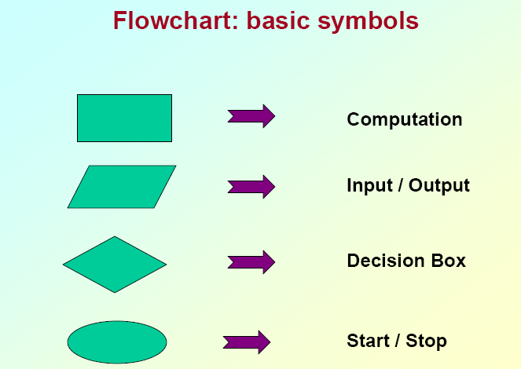

Slide 5
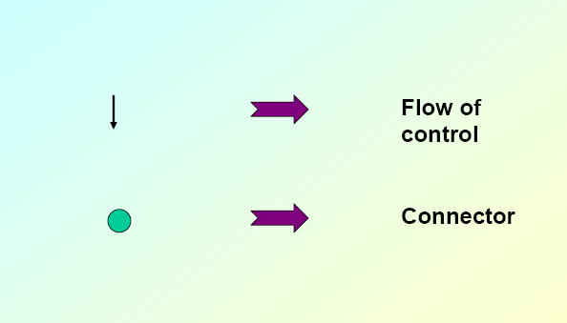

Slide 6
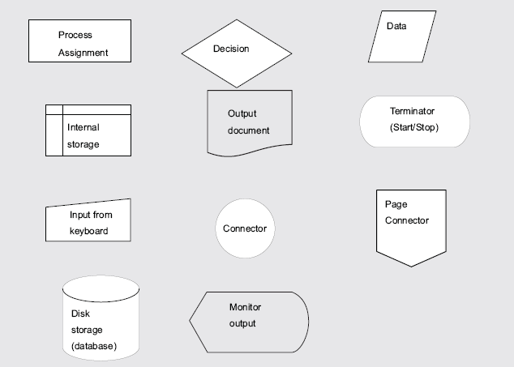

Slide 7
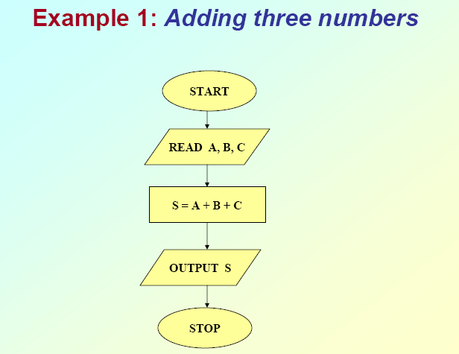

Slide 8
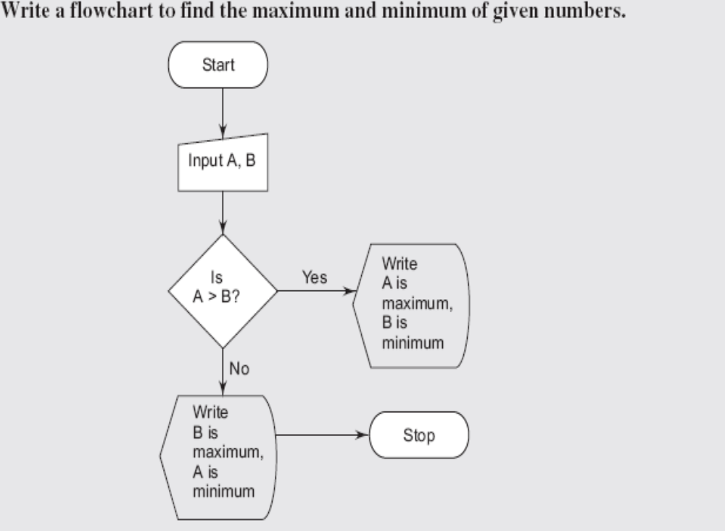

Slide 9
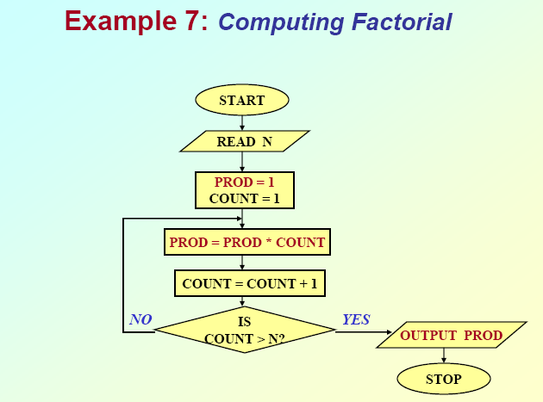

Slide 10
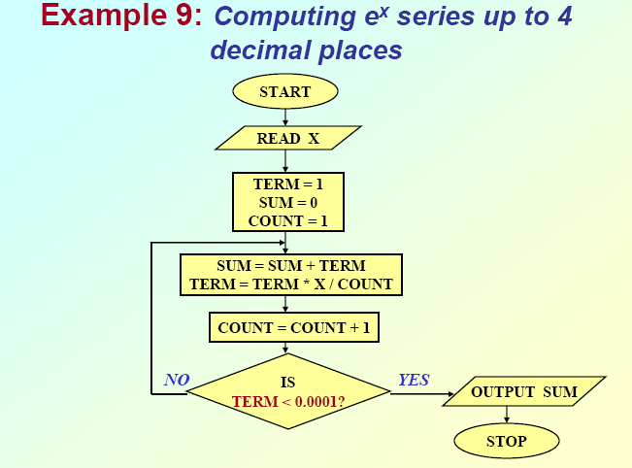

Slide 11
ASCII Code
0 | 1 | 2 | 3 | 4 | 5 | 6 | 7 | 8 | 9
48 | 49 | 50 | 51 | 52 | 53 | 54 | 55 | 56 | 57
A | B | C | D | E | F | G | H | I | J
65 | 66 | 67 | 68 | 69 | 70 | 71 | 72 | 73 | 74
a | b | c | d | e | f | g | h | i | j
97 | 98 | 99 | 100 | 101 | 102 | 103 | 104 | 105 | 106
NULL (\0) |  | BEL (\g) |  | TAB (\t) |  | NEWLINE (\n) |  | SPACE
0 |  | 7 |  | 9 |  | 10 |  | 32

Slide 12
/*Wap To print ASCII Values*/
#include <stdio.h>
main()
{ char first_letter;
first_letter = ‘A’;
printf("Character %c\n", first_letter);
printf("ASCII value %d\n", first_letter);
getch();
}
Example: Example:
Character ‘A’ Character ‘a’
ASCII value 65 ASCII value 97

